Slide 1
Control Charts and Change Point Detection

Slide 2
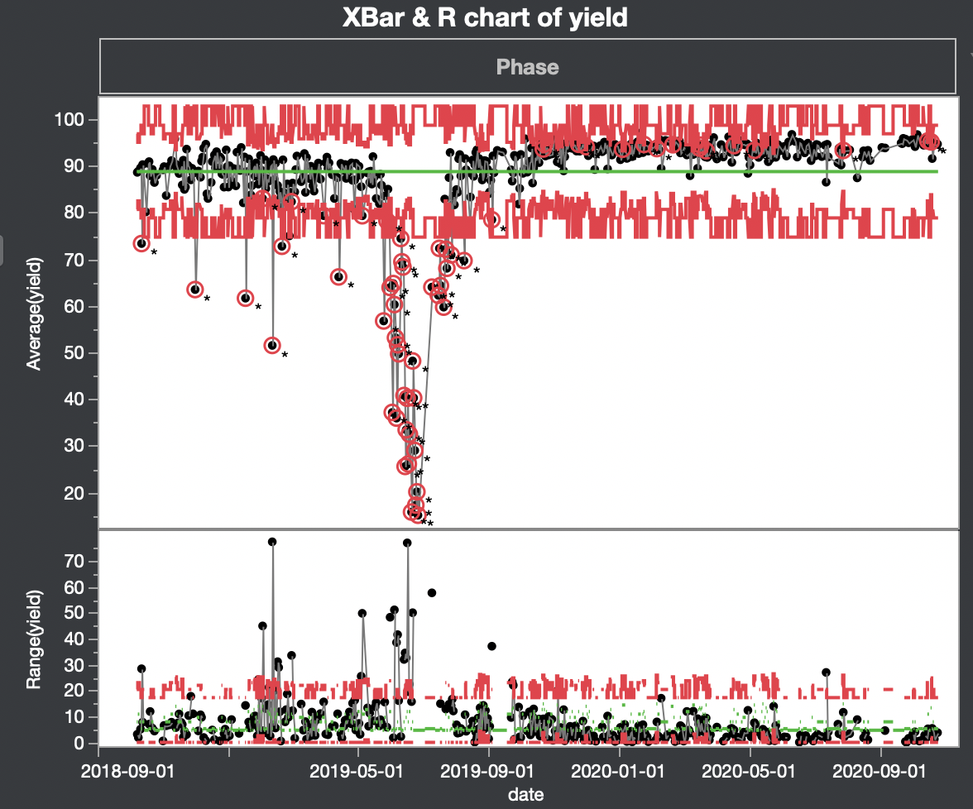
Control Charts on JMP
Graphical and analytic tool for monitoring process variation
Pretty straight forward and automated, anyone can do it with JMP
JMP creates variable control limits based on your data and tells you when a data point is outside the control limit.

Slide 3
Change Point Detection
Analysis algorithms to detect abrupt shifts in a time series trend
Multiple search methods for change point:
PELT (Pruned Exact Linear Time) – Creates a cost function for time series and derives change points from minimizing the cost function. Pretty consistent results. O(n) very fast.
Dynamic programing – Also looks to minimize cost but does so with a dynamic programing approach (very iterative, imagine “finding the shortest path” scenario, breaks the problem down into many smaller problems and iterate until you find the shortest path)
Window based – Shift 2 windows down the trend, when the two windows have a large difference, that’s your change point
Binary segmentation – Iteratively apply a change point and see if a split occurs.

Slide 4
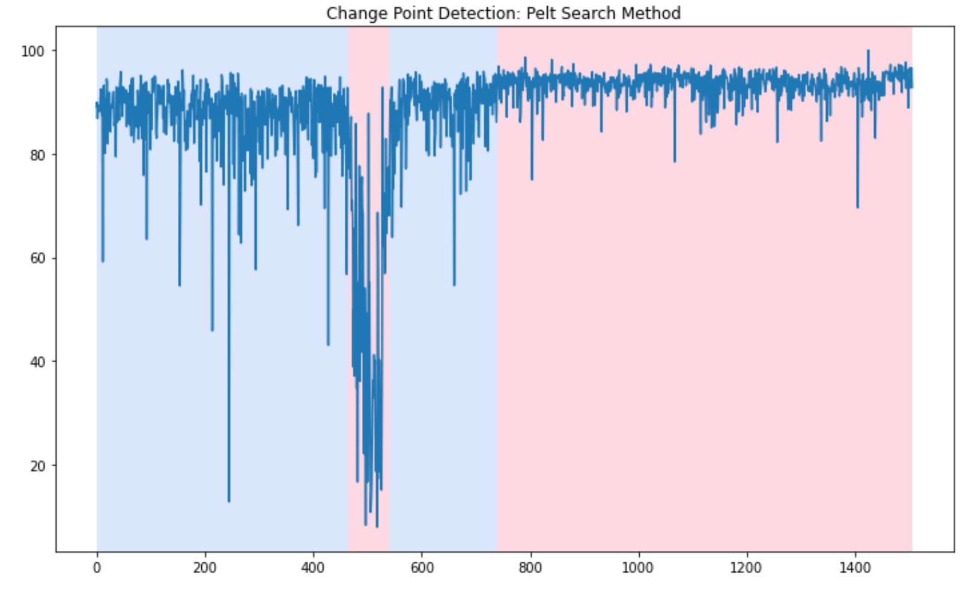
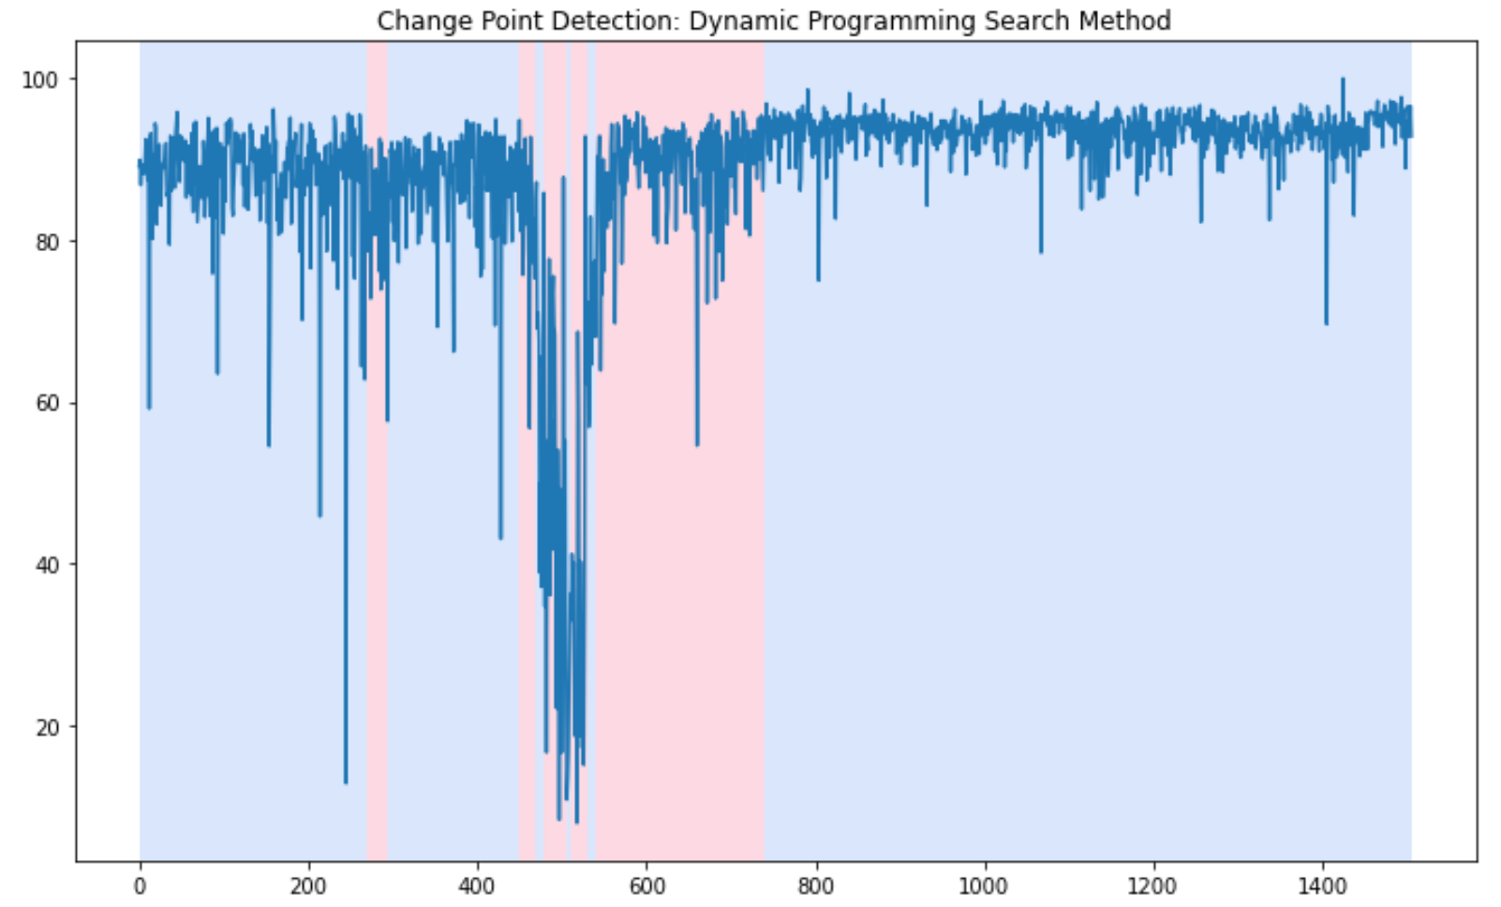
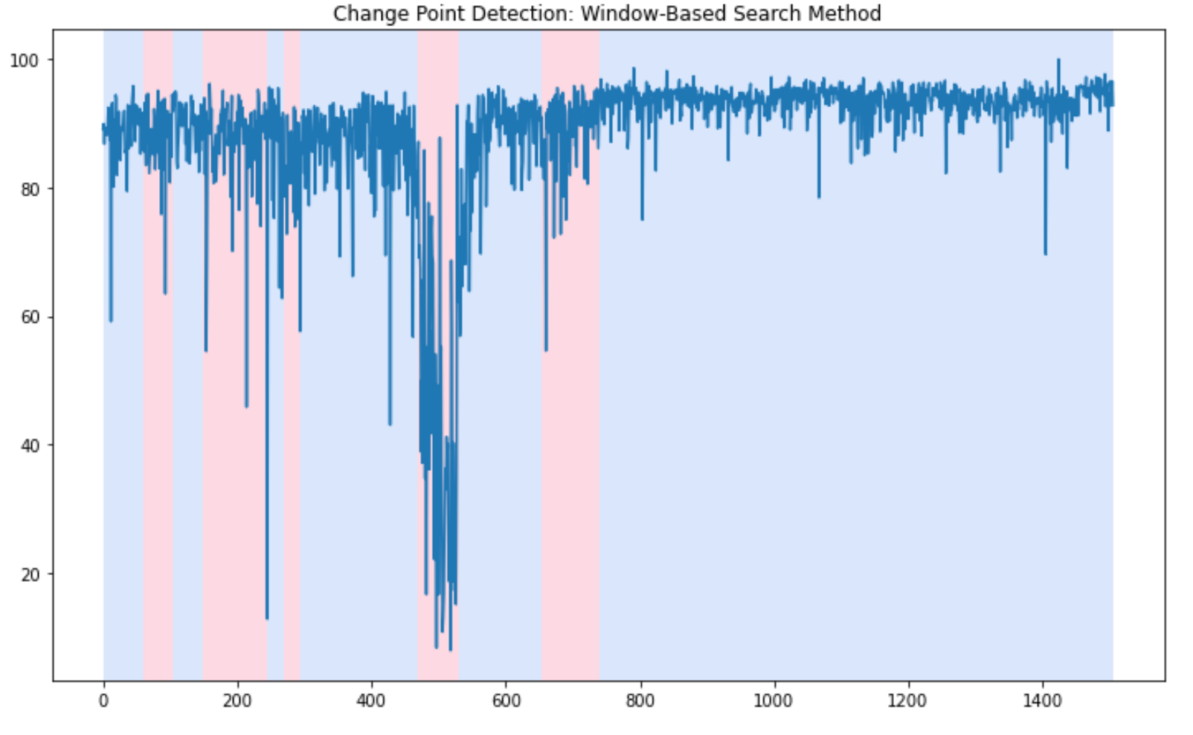
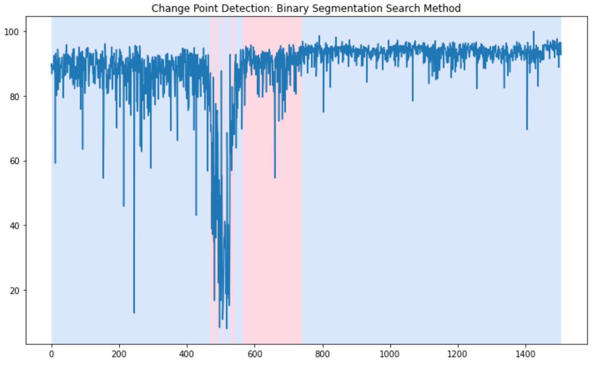
Using 14hp Diagon Yield as example (800 days)
Notes:
Pfet epi thickness
Tox gl parms from vidya
14hp examples from dan

Slide 5
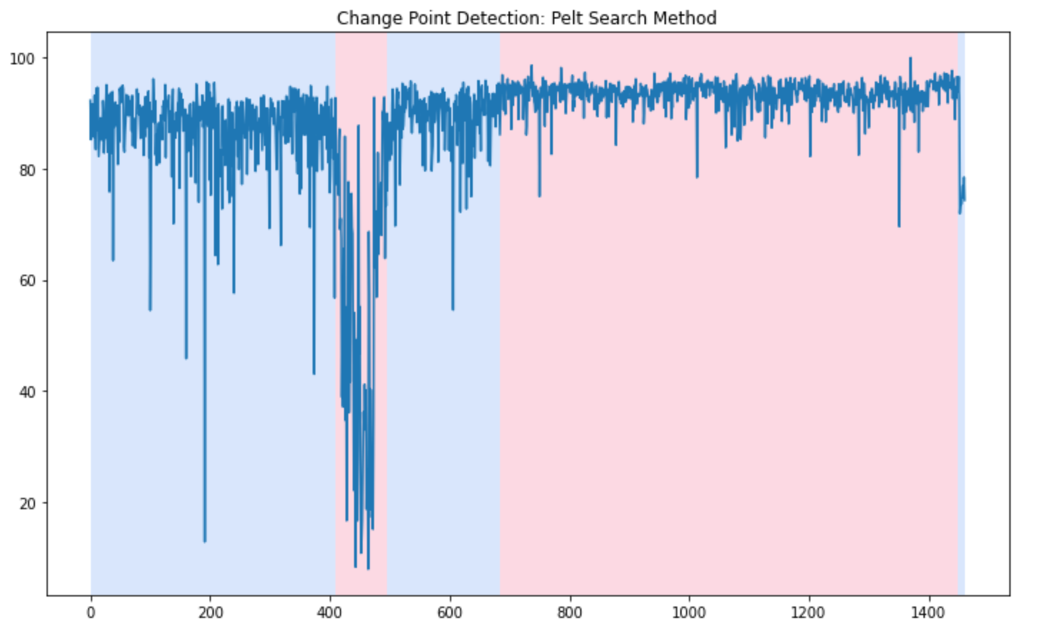
Std = 2.5
If new trend is at 75.0% yield with standard deviation of 2.5 (similar to the standard deviation we got in good DG yield time frame), it takes 9 data points to detect a change.
Repeated experiment 4 times and always detected change at 9 data points

Slide 6
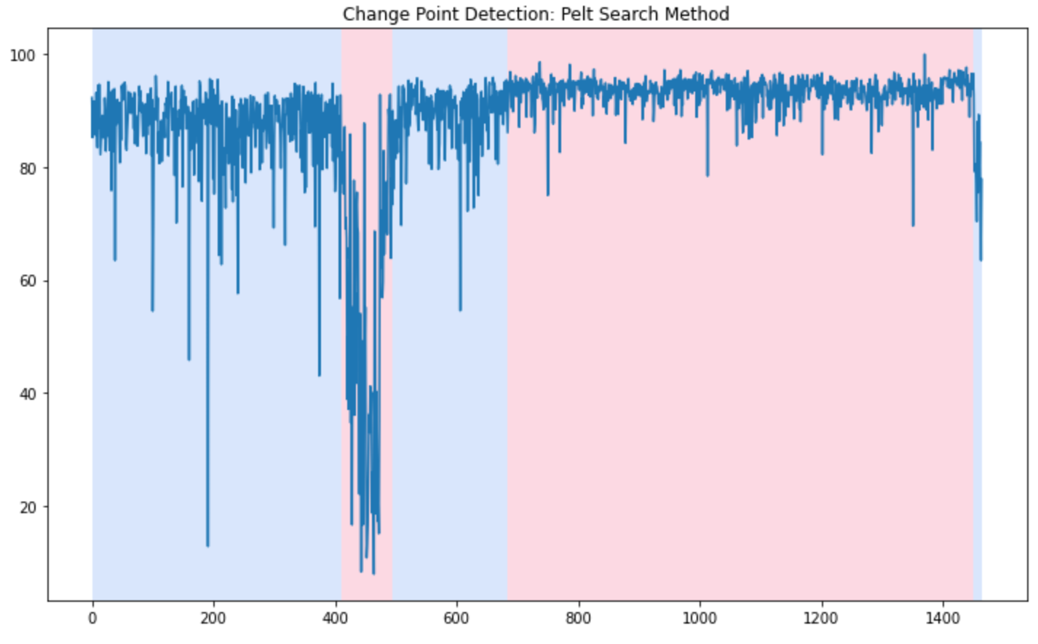
Std = 8
If new trend is at 75.0% yield with standard deviation of 8 (similar to the standard deviation we got in an old DG time frame), it takes 12.6 data points to detect a change.
Repeated experiment 10 times and detected change on average at 12.6 data points (13,12,12,15,12,11,12,13,13,13).

Slide 7
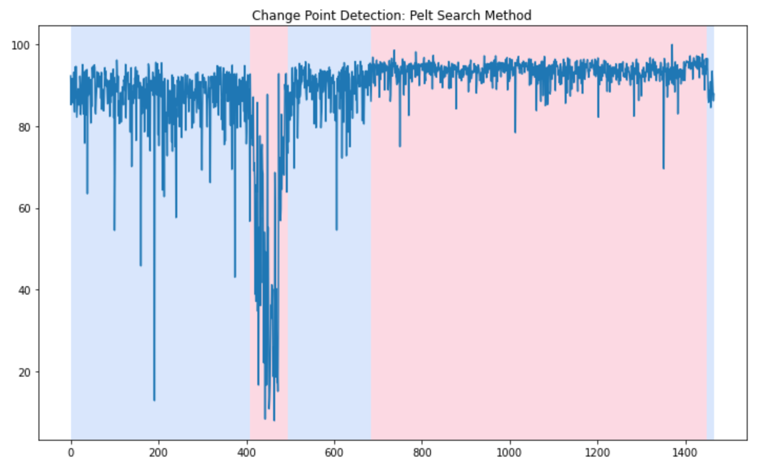
If new trend is at 87.5% yield with standard deviation of 2.5, it takes 13.3 data points to detect a change. Repeated experiment 10 times and detected change at an average of 13.3 data points (14,11,12,15,12,12,13,13,15,16).

Slide 8
Conclusion
If new trend has large standard deviation it would require more data points
If new trend has a mean close to the old trend, it would require more data points
Still requires 9 new data points if new trend has large mean delta and small standard deviation.
9 new lots is a lot for 7nm

Slide 9
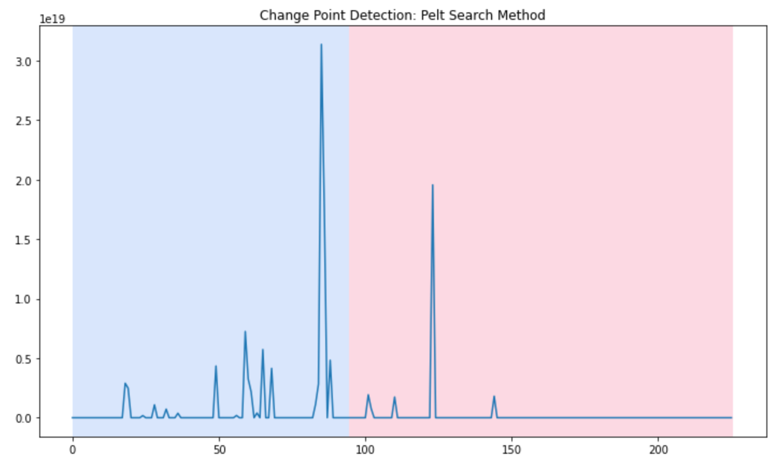
Using Dan’s L200 parameter from 14nm
Some extreme high flyers seems to break the code?
No, next slide shows that the break seems legitimate, just not visible.

Slide 10
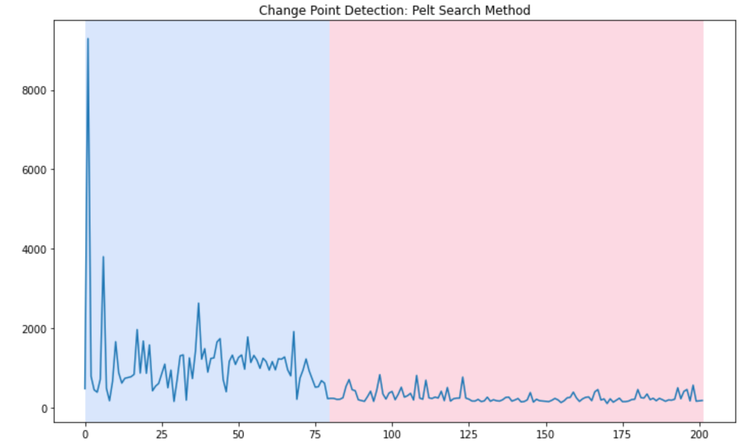
Filtered out data points that are greater than 10,000
Looks like break point is similar. Maybe extremely large outliers will not break the code as long as there aren’t too many of them. Won’t be as obvious visually though.

Slide 11
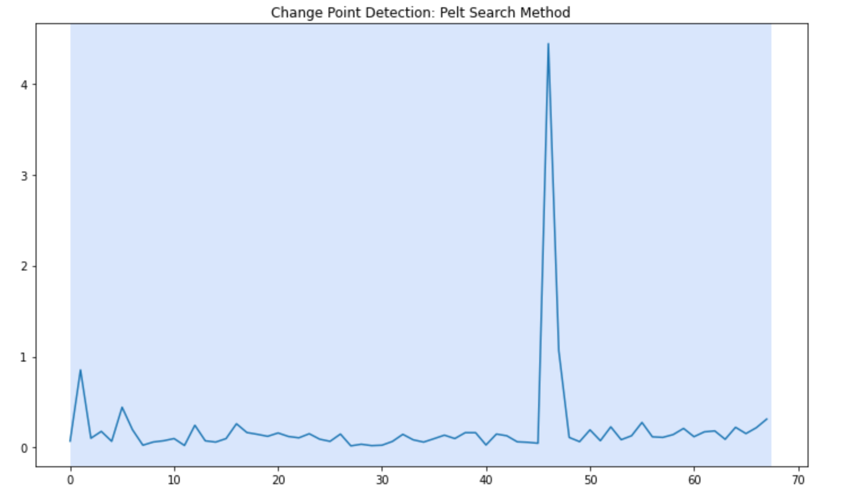
PFET Long Channel Gate Leakage DLW_P_LVT_30_90_DDB_4_Iginv@0.75V_LT
There are no shifts in the trend so no change points are detected.

Slide 12
Control charts can catch outliers but it is not detecting the dips (which are good lots) as the outliers

